Slide 1
Co-funded by the
European Union
Resilience to Change:
Building Strong Models for a Sustainable Business
Social partners supporting anticipation and management of change after COVID-19 : SPAM-COVID19
Presentation of Research
Michaela Vassallo

Slide 2
AGENDA
Context
Introduction
Main Findings - Employee Survey
Main Findings - Employer Survey
General Conclusion from both Surveys
Larana Inc.

Slide 3
Our recent surveys, conducted with both employees and employers, garnered an impressive response, with approximately 200 participants.
The valuable insights we gathered will be channeled into the creation of a comprehensive manual, for our project, ‘Regeneration Plan for Workplaces’.
This manual will soon be made available, offering practical solutions and recommendations based on our research findings, carefully analysed and validated by our expert, Mr Robert Debono.
CONTEXT
Larana Inc.

Slide 4
Presentation of Research
The 'Social Partners Supporting Anticipation and Management of Change after COVID' is an EU-funded project that has been dedicated to understanding and facilitating the transformation of workplaces in a post-pandemic world.
As part of our efforts, we conducted surveys, and today, we are excited to present some of the key findings that have emerged from our research. These insights are the result of extensive data collection and analysis, and they offer valuable perspectives on how organisations are adapting and evolving in response to the challenges posed by the COVID-19 pandemic.
Introduction
Larana Inc.

Slide 5
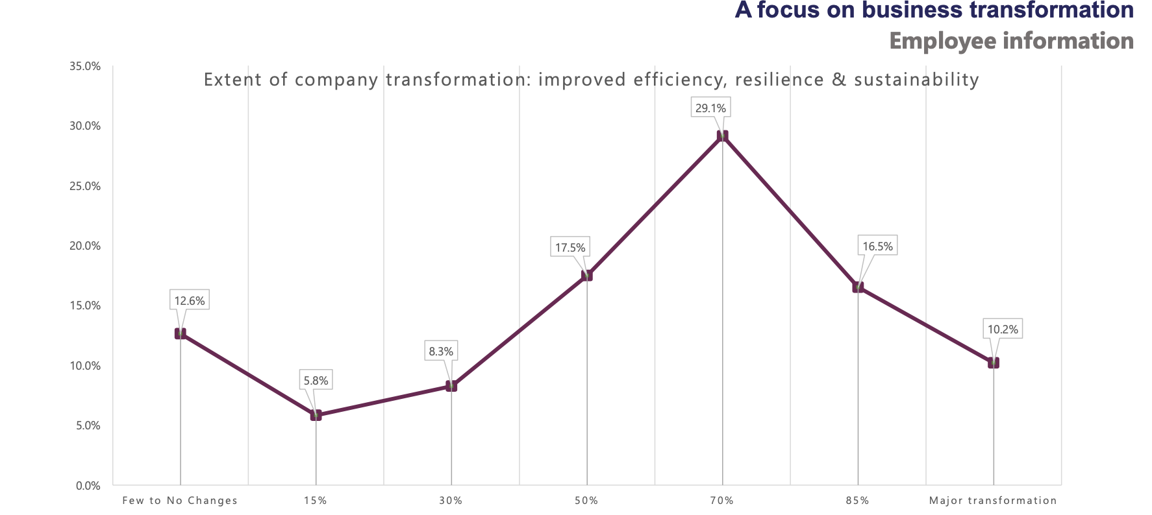
MAIN FINDINGS - EMPLOYEE SURVEY
Job Changes Post-Pandemic
46.2% of employees reported job changes due to pandemic-driven transformations.
11.2% experienced extensive job changes.
Workplace efficiency and Sustainability
Nearly 46% found the workplace transformations made their workplace more efficient, resilient, and sustainable.
10.2% saw a 100% improvement.
Larana Inc.

Slide 6
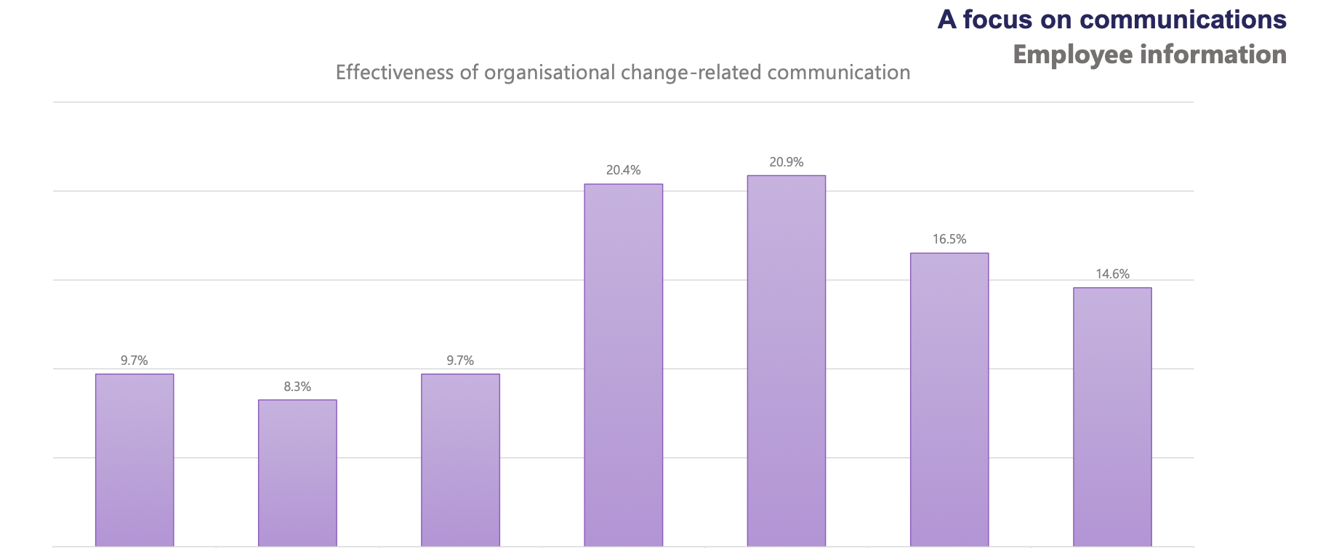
MAIN FINDINGS - EMPLOYEE SURVEY
Communication Assessment
28% of employees felt that the communication prior to transformation was weak.
20% had a neutral opinion.
The remaining 52% found it satisfactory, strong, or excellent, with 15% rating it as excellent.
Larana Inc.

Slide 7
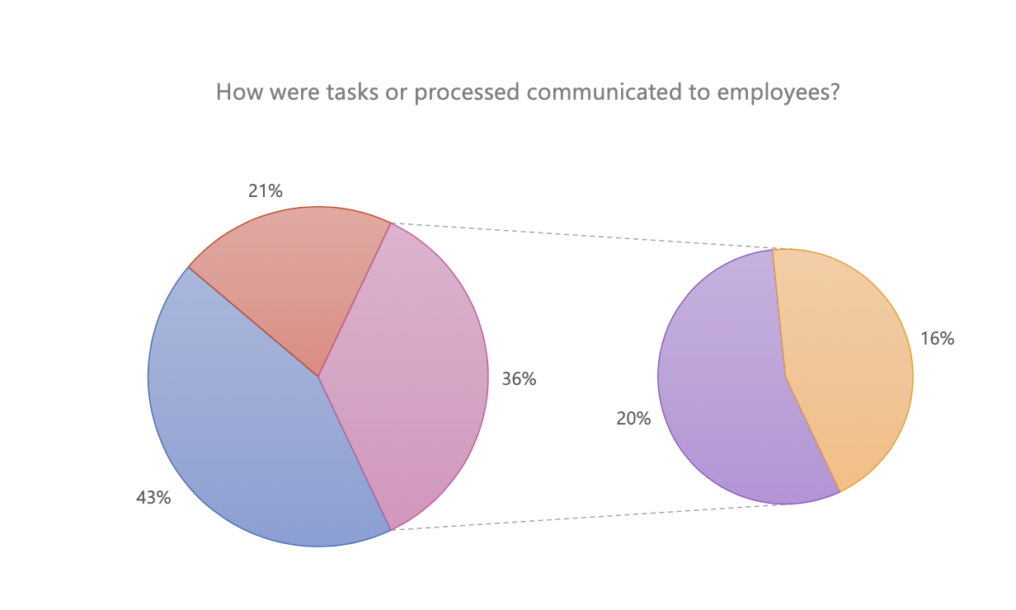
MAIN FINDINGS - EMPLOYEE SURVEY
Employee Perceptions of Change and Communication
43% felt changes were well-communicated and maintained control.
About 21% felt uneasy despite good communication.
20% felt in control despite poor communication.
16% felt uneasy due to inadequate communication.
Larana Inc.

Slide 8
MAIN FINDINGS - EMPLOYER SURVEY
Business Strategy
81.2% of companies surveyed reported having a business strategy in place.
5% had no strategy, and 13% were uncertain about their strategy status.
Larana Inc.

Slide 9
MAIN FINDINGS - EMPLOYER SURVEY
Impact on Efficiency, Resilience, and Sustainability
Responses were positively skewed.
64% reported varying degrees of improvement in these areas.
An additional 24% gave a neutral response.
Larana Inc.

Slide 10
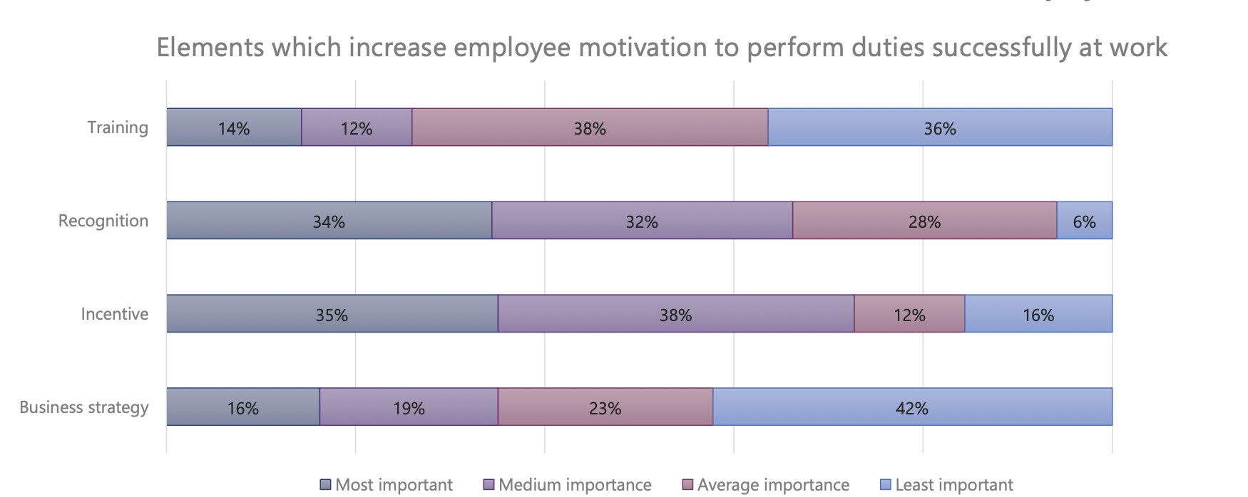
MAIN FINDINGS - EMPLOYER SURVEY
Employee Motivation Factors
Recognition and Incentive were rated as the most important by employers (34% and 35%).
32% and 38% rated them as "medium importance.”
Business Strategy was considered most important by only 16%, and Training by 14% of employers.
Larana Inc.

Slide 11
GENERAL CONCLUSION
Challenges in Business Transformation
Weak planning and communication between management and employees were identified as barriers to successful business transformation.
Employees are receptive to change when they are actively involved and well-trained, preferring to work smarter, not harder.
Emphasis on Innovation
Organisations acknowledge the need for continuous innovation to address rising competitive pressures, ensuring resilience and competitiveness.
Unexpected Findings
Surprisingly, a notable proportion of employers reported no change in productivity post-transformation.
Workplaces and processes were often perceived as more complex when changes were poorly engineered and solely focused on digitalisation.
Larana Inc.

Slide 12
THANK YOU
admin@maltaemployers.com
www.maltaemployers.com | www.regenerationworkplace.eu
Regeneration Plan for Workplaces
Regeneration Plan for Workplaces

